Slide 1
Leeds Civic Trust 50th Anniversary
The Next Fifty Years:
Visions for the Future of Leeds
How could global, national, regional and local trends influence the way Leeds develops?
Rachael Unsworth Future Directions
Jamie Saunders Futuresedge
Hosted by

Slide 2
Looking over the horizon
“This present moment used to be the unimaginable future”
Brand, S. (1999) p.164
Notes:
The Victorian artist would have been unable to imagine that 150 years after the opening of the Town Hall, such a structure would be part of the city centre.
It is indeed very hard to think that far ahead. But there is a great appetite for trying to work out what the future might hold – tomorrow, next week, month, year, a few years out. A better sense of the future reduces the risk attached to decision making and increases the chances of significant gains. Looking forward also gives us a chance to reconsider: will we merely react to unfolding circumstances or will we try to alter the trends that would otherwise deliver that future? The power of foresight means that we are able to imagine different futures and to some extent, in some circumstances, bring them about.
So this event is more about putting across ways of thinking than about giving any particular view about trends and how they might play out over the next half century. It is intended to give the Trust a boost in becoming even more of an influence over the direction of change in the city – to start a process of making constructive long-term thinking much more common.

Slide 3
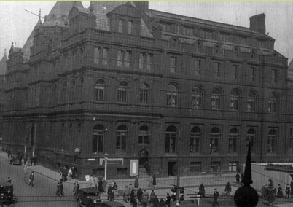
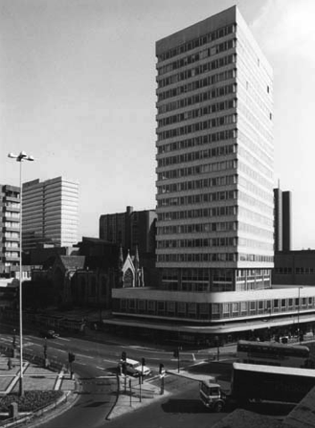
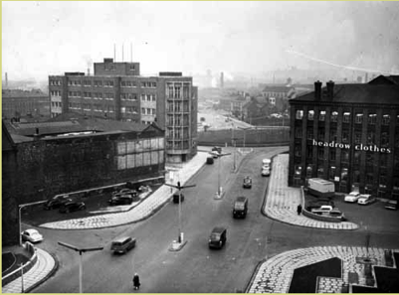
Leeds in 1965
Notes:
1969: Civic Trust document, reporting on an open forum of Trust members. What sort of city did members think it was at that time?
Drab, lacking focus, lifeless at night, modern buildings soulless, pedestrians disadvantaged and too many sites taken over by car parks, lack of greenery, riverside neglected. Centre should have residents as well as retail and entertainment.
The Trust started with an urgent agenda of saving some of the historic structures of the city. That is still an important element of our work. But we see the historic elements of the city as an integrated part of endless urban evolution. The Trust is listened to. We could have even more influence if we had a stronger sense of the sort of city that we would like to bequeath to posterity.

Slide 4
Outline
Ways of looking into the future
Trends
Foresight about these trends
Deciding what to do:
preparing to go with trends
OR
taking steps to change direction
Notes:
How can we look ahead?
How can an understanding of current trends – direction, strength, more or less likely consequences – be helpful in considering the future of the city?
How can we work out more or less likely futures? How much help are forecasts? What if we don’t like the more probable prospects?
What other techniques are there for helping us to plan ahead and shape the future?
So this event is more about putting across ways of thinking than about giving any particular view about trends and how they might play out over the next half century. It is intended to give the Trust a boost in becoming even more of an influence over the direction of change in the city – to start a process of making constructive long-term thinking much more common.

Slide 5
Some futures vocabulary
foresight
projection
forecast
scenarios
visioning
Notes:
A projection is based on an understanding of the relationship between variables: how the independent or explanatory variables generate the output. The longer the run of data available, the greater chance there is of the relationship between the variables being more firmly established and therefore of a forecast based on the projections being more accurate. Forecasters look for variables that are ‘in lock step’.
Forecasts are usually presented in terms of probability – this is the case with the IPCC forecasts of global temperature rise.
Forecasts are not predictions.
All forecasting requires judgment – selection of method, formulating of model – selection of independent variables. More usually, though, the term is associated with forecasts based wholly on judgment, or on judgmental adjustments to statistical forecasts.
Greater reliability in assessing the probability of an event than in predicting the exact quantity of some future occurrence. Eg. it is easier to commit to a view that it likely more likely that the price of energy will be higher in a year’s time than to specify exactly how much higher it will be.

Slide 6
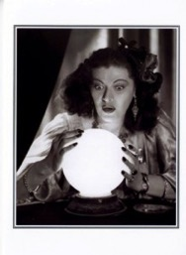
Reliable crystal balls not yet available
“Beyond a small set of certainties, knowing what the future holds ... can only be opinion, even when supported by complicated modelling”.
Loveridge, D. (2009) Foresight: the art and science of anticipating the future, London: Routledge, p.2.
Notes:
Forecasting is technically sophisticated, requiring mathematical and computing knowledge, but it doesn’t mean to say that it will be accurate – certainly over a long time horizon. Wilkinson, A. (2012): “We live in an era of fractured and cloudy crystal balls”. Enterprise and the environment: the futures agenda http://www.smithschool.ox.ac.uk/smith-in-the-city-evening-seminar-series/
“Choose a major national or international event of the last three decades of the 20th century; go back ten, or even just five years, and try to find out if anybody’s forecast fits. You will immediately start piling up a long list of hugely important events that were entirely unanticipated only five years before they took place” [Smil, V. (2004) China’s past, China’s future: energy, food, environment, London: Routledge. p.208].
Economist John Kay (Oxford, LSE, London Business School and writer for the FT) says that anyone who claims to be able to forecast such things as the level of the stock market next year or the demand for air travel in 2015 is a ‘charlatan’! Our efforts should be not to predict the future but to gain a better understanding of complex systems (Kay, J. 2003, The truth about markets, Penguin, p.116).

Slide 7
Research about reliability of forecasts
Tetlock, P.E. (2005) Expert political judgment:
tested 284 experts in political science, economics, history and journalism
included 82,361 predictions
Findings:
they did little better than a dart-throwing chimpanzee
‘foxes’who know a little about many things do better than‘hedgehogs’who know a lot about one area of expertise
Notes:
Shermer, M. (2011) Financial flimflam: why economic experts’ predictions fail, Scientific American, March, p.69.

Slide 8
Trends relevant to the future of cities?
Economic
Technological
Demographic
Social
Environmental
Political
...

Slide 9
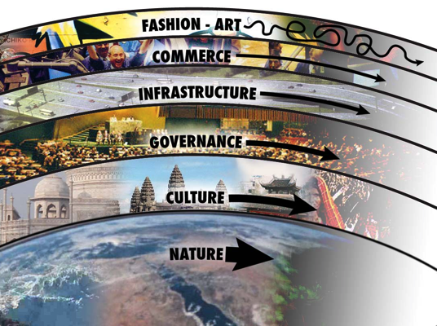
Trends move at different paces
More rapid change
The pace layers
Notes:
Landry, C. (2004) Riding the rapids: urban life in an age of complexity, London: Building Futures, RIBA.
“The past will continue to exert enormous influence on the present and future, so to a large extent the future has already been shaped and determined” (p.15).
Diagram from Brand, S. (1999) The clock of the long now, New York: Basic Books, p.37.

Slide 10
Some trends are more definite – for example:
Economic & Technological
falling cost of technology + expansion of digital
decreasing availability of fossil fuels
expansion of knowledge economy, sharing economy, circular economy
Demographic
ageing population
lower fertility rates
Social
continuing demand for face-to-face but greater flexibility
Environmental
increasing threats to biodiversity
growing impact of climate change
Political
Unequal access to resources and opportunities
Notes:
The future is inherently uncertain, but if everything were equally and completely uncertain then there would be no point trying to engage in futures work. Some elements of any situation are to a degree predictable. So we aim to maximise knowledge and understanding of the elements of the future that are least uncertain and develop more awareness of those that are more uncertain (Van der Heijden, 1998, Scenario planning, in Wright and Goodwin, 39-63).
How do we know? There are long term data sets and these are established ‘secular’ forces (long term); seasonal forces, cyclical forces (wavelike) and accidental or irregular forces. Morgan, M. (1990) The history of econometric ideas, Cambridge: CUP.
Paul Saffo (Long Now seminar: The Creator Economy): We consider the ‘cone of uncertainty’ ahead of us and try to consider the edges, pathways, actions that might be taken to influence outcomes. We aim to give some robustness to intuition.

Slide 11
What might be the implications of these trends for cities?
constraints on wealth creation – different approaches to value, rewards, funding, spending
more attention to connections and inclusivity
changing travel patterns and thus infrastructure
less or different spending: less demand for retail property
less demand for office space – especially out of town
More demand for creative space
changing requirements for education
targeted information delivered in real time
higher priority to greening
support for more growing space
more options for free activities – act as a draw
●●● your thoughts?
Notes:
Much depends on political outlook. But with longer term thinking, more likely to unite around shared goals?
More flexible use of space instead of clearly differentiated activities in specifically dedicated spaces.
Designing, building, managing the environment for the long term.
Actively working to reduce inequalities of access, opportunity, involvement.

Slide 12
More uncertain futures
Impacts of climate change?
Technology?
Migration?
International power relations?
Governance?

Slide 13
How should the city react? Civic Trust’s role?
predict and control?
try to accommodate changes that cannot be avoided?
prepare for all eventualities?
try to counteract negative changes and promote positive ones?
mix of approaches?
Notes:
The modernist view of planning as ‘predict and control’ yet it is evident that what is needed is continuous learning to improve understanding of trends and their potential implications.

Slide 14
Forecasting or scenarios?
“Predicting exactly how cities are going to grow was extremely difficult because every city does it a little bit differently. So what we did was to look at what we saw as the two extreme, yet realistic scenarios”.
Eigenbrod, F. (2011), University of Southampton: study of urban development and ecosystem services
Notes:
The impact of projected increases in urbanization on ecosystem services
Eigenbrod, F., Bell, V.A., Davies, H.N., Heinemeyer, A., Armsworth, P.R. and Gaston, K.J. (2011) The impact of projected increases in urbanization on ecosystem services. Proceedings of The Royal Society B Biological Sciences(doi:10.1098/rspb.2010.2754) (PMID:21389035)

Slide 15
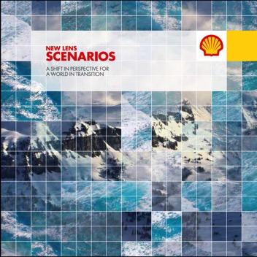
Scenario planning – pioneered by Shell from 1970s
Scenarios are stories that consider “what if?” questions
Forecasts focus on probabilities
Scenarios consider a range of plausible futures & how these could emerge from the realities of today
Notes:
http://www.shell.com/global/future-energy/scenarios.html

Slide 16
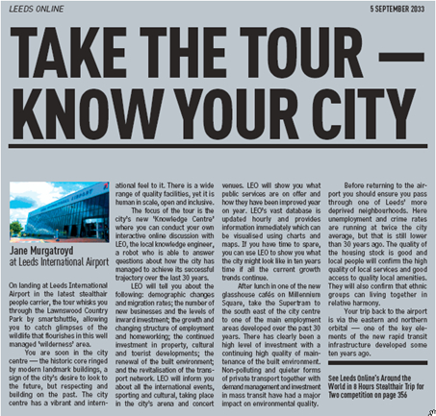
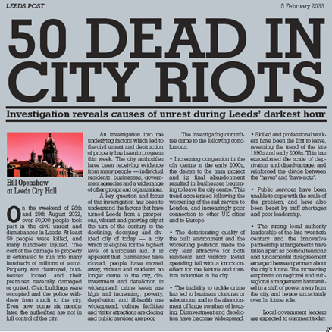
Scenarios from 21st Century Leeds
In which cities around the world has the vision of one person or group been crucial?
Notes:
Our attempt to think about how the city of Leeds might be if everything was hunky-dory or pear-shaped.
Unsworth, R. and Stillwell, J. (2004) 21ST Century Leeds: geographies of a regional city, Ch. 16.

Slide 17
Why use scenarios?
Scenarios help an organisation to understand and manage the future more effectively.
How?
Enable exploration of how the future might be: how drivers, trends and other factors could combine to produce a series of different futures.
Notes:
Foresight is underpinned by an understanding of the most likely directions of change in the economy, technology, competition, social and demographic trends, consumer needs and attitudes. “Statistical methods, which rely on extrapolating historical patterns, are unlikely to capture changes that will occur in the future” (p.xi). In contrast, scenario planning does not involve forecasting. Instead, multiple plausible futures are constructed which bound the critical uncertainties and trends that are seen to have an impact on the future. Subjective probabilities are not attached to individual scenarios, since each has a very low probability of actually happening. Instead, an organisation’s strategy can be tested for robustness against the scenarios: how would we react if this kind of future unfurled? It is akin to testing a physical product under different levels of stress from different directions.
Wright, G. and Goodwin, P. (1998) Forecasting with judgement, Chichester: J Wiley & Sons.
Scenario planning moves decision makers from ‘will this happen?’ to ‘what will we do if this happens?’ and so ‘What does this mean for what we do now?’ (van der Heijden, 1998).
"Scenarios treat the future as fiction rather than an objective reality. By doing so they harness intuition alongside imagination and coupled to rigorous analysis help clarify present day priorities and options. Their value lies in revealing and testing assumptions, in reframing and re-perceiving the present rather than forecasting the future. In forecasting we assume the future will continue as the past and that the challenge of the future is a deficit of data and, as such, uncertainty increases the further we look into the future.
When we work with scenarios we look to see why the future might break with the past and harness this to reveal the assumptions we are making about the future. In effect, we recognize the uncertainty and ambiguity of the present, not the uncertainty out there in the future” Wilkinson (2012).

Slide 18
From scenarios to visioning
A preferred future requires vision
Vision without discipline is daydream
(Haig, 1984 – quoted by Loveridge, p.14).
Notes:
In other words, it is pointless to imagine a desirable future without any understanding of constraining factors and more likely possibilities. It is necessary to go through a rigorous process of understanding the context and the trends and assessing the plausibility of different futures and the risks associated with them.
With a 50-year time horizon there is a chance to be imaginative. What would be an ‘ideal’ future in terms of accessibility, mobility and infrastructure all that time ahead? What is most feasible, given possible/likely economic, demographic, political, social technological, environmental continuity and change? VERY challenging questions!! The main point of these events is to suggest that with a sufficiently distant time horizon and some seriously imaginative thinking, we can anticipate unavoidable change and prepare ourselves and also create a vision of what might be preferable to just letting the future break over us. Only with a strong vision of the future do we stand a chance of not just bumbling along with piecemeal, reactive change. And a strong vision with a far time horizon, jointly constructed, can unite people who would be at loggerheads over immediate changes on their doorstep within the next electoral cycle. ”We don’t know what’s coming. We do know we’re in it together” (Brand, 1999, p.123)

Slide 19
Preferred future
Using VISIONING:
non-mathematical
participatory
looking further ahead than forecasting can
systematic
Notes:
There follow some examples of scenario sets.

Slide 20
Dator’s 4 (American) scenarios
1. Continued growth – persistence of general characteristics of society
2. Societal collapse – driven by resource shortages, climate change, human and natural disasters. Political or administrative ineptness
3. A conserver society – managed shrinkage rather than growth
4. The transformational society – fundamental paradigm shift to new institutional and technological arrangements fundamentally different from anything seen before
Notes:
Scenarios are often generated as a pack of four with two axes: a ‘business-as-usual’ version, a complete disaster and then two that are somewhat more positive.
1. Continued growth – the persistence of the general characteristics of society – growth-oriented, opportunity-filled, technologically-progressive, upwardly-mobile, internationally-dominant, science-guided, rich, leisure-filled, abundant, and liberal
2. Societal collapse – driven by resource shortages, food shortages, climate change, environmental disasters, widespread natural or human-made diseases, earthquakes, volcanic eruptions and other "acts of god." Political or administrative ineptness or a snowballing series of pure accidents or terroristic events, nuclear war or some combination of these lead to a slide of our present "high civilization" into conditions not unlike the early Dark Ages in Europe – or worse.
3. A conserver society – the "Good Ship Industrial Growth" cannot persist; it is already beginning to sink. We need a managed shrinkage rather than growth.
4. The transformational society – American society over the next 30 to 50 years (from 1977) will go through a fundamental paradigm shift which will be a challenging "birth-like" process. Some advocates of this image parallel those who call for the conserver society, but see new value, institutional, and technological arrangements fundamentally different from anything we have seen before.
Dator, J. (1981) Alternative futures & the futures of law. In James Dator & Clement Bezold (Eds.) Judging the future (1-17). Honolulu, HI: University of Hawaii Press.

Slide 21
Forum for the Future, scenarios Dec 2008
“We have created four plausible scenarios showing how the world may look in ten years’ time to guide companies on the best sustainability approach today.
The scenarios are informed by the Forum’s long experience of using futures techniques to help major companies develop and implement more sustainable strategies” (p.5).
Notes:
http://www.forumforthefuture.org/project/acting-now-positive-2018/overview

Slide 22
Forum for the Future, scenarios Dec 2008
Global Interest An effective globalised response to global challenges prompts increased resource productivity and low-carbon growth. Companies have to play a greater role in supporting public services and infrastructure but reap the benefits of a broadly free, stable and prosperous world. | National Interest Nations hoard their own resources and tighten their borders in a retreat to nationalism and protectionism. Global businesses all but disappear and companies are expected to support the national interest.
Patched-up Globalisation Emerging markets rise as China stalls. Low-carbon technologies thrive, particularly biofuels. Successful companies are multinationals with a local feel, helping to deliver local development needs. | Me and Mine, Online A highly networked world undermines individual countries and companies. Successful companies are now more like branded hubs, coordinating often temporary and short-lived supplier relationships to deliver customised products.
Notes:
http://www.forumforthefuture.org/project/acting-now-positive-2018/overview

Slide 23
A future scenario based on detailed understanding of a wide range of trends
Tomorrow’s successful organisations will
Satisfy emotional & spiritual need rather than gratuitous wants
Satisfy essential needs in the lower orders of Maslow’s Pyramid
Employ people rather than energy
Create or use renewable energy & other resources
Minimise water use or create the technologies that do
Create & deploy climate stabilising & mitigation technologies
Be increasingly local
Provide a service rather than a product
Practice lifecycle stewardship of their resources
Manage value rather than cost
Be able to operate at continually reducing resource intensity
Notes:
Managing for the future: a Systems Approach. Derek Deighton & Jackie Ansbro, Trailblazer Business Futures
If a city council took this set of ideas on board, what sort of city would they plan?

Slide 24
“Choosing between different scenarios for the future is a complex business. It involves imagination as to what could possibly be achieved as well as practical judgment over what can actually be achieved. It involves debates between people and organisations to discuss critical choices about alternative development paths with different impacts. And it involves understanding these impacts and identifying impacts that might otherwise go unconsidered (including perverse outcomes - RU). But the central political problem is that the impacts of urban change fall variably on different people, groups and organisations” (Rydin, 2011, p.9).
Notes:
Planning is a means for society to collectively decide what urban change should be like and to try to achieve that vision.
It is inherently political, meaning that there are different interest groups vying for different kinds of futures. Any attempt to do forward planning is beset by the need to consider different interests and by the imperfect understanding of what the future might hold with or without intervention.
But using futures thinking is very different from the technical, rational approach of modernist planning (Davoudi, S. (2012) The legacy of positivism and the emergence of (the) interpretive tradition in spatial planning, Regional Studies 46(4), pp. 429-441).

Slide 25
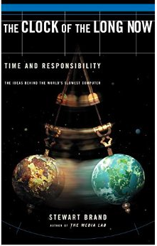
Clock of the Long Now – an ambitious project
Don’t hold back!
The more over-the-top a project is, the better it works
p.48
A traditional clock depicts time in the context of our lives.
This clock depicts our lives in the context of time.
Notes:
p.104: “The ultimate reason for initiating something ambitious is not to fulfill certain notions but to find out what surprises might emerge”.

Slide 26
The future is to be constructed rather than divined
“A careful reading of history shows that the outcomes of complex developments are often much less circumscribed than is commonly believed. The combination of biophysical constraints, burdens of history, and peculiarities of culture and politics counts for a lot – but it does not preordain the future. Closer looks at complex situations always reveal the existence of contending trends, and hence of realistic choices. Every one of them can be handled in one of three basic ways: vigorously pursued, largely ignored or aggressively opposed – or with countless, and shifting, nuances in between. The long-term balance of these complex interplays determines the outcome”.
Smil, V. (2004) China’s past, China’s future: energy, food, environment, London: RoutledgeCurzon, p.212-213.

Slide 27
The Civic Trust and The Long Now
Stewards of the memories of the city but also influencers of its future shape and functioning
“The accumulated past is life’s best resource for innovation” (p.75)
European “clock of the long now”?

Slide 28
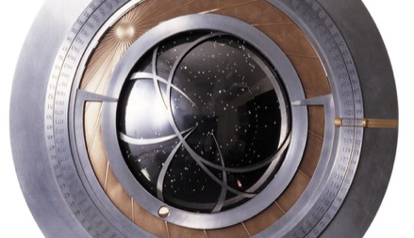
Postcards to the Future
Your aspirations for the Civic Trust 2065
Vision
Why? How?
Your aspirations for the city 2065
Vision
Why? How?
Notes:
You are invited to send postcards to the future – an idea borrowed from one of our major sources and influences, The Clock of the Long Now.
Aspirations for the Civic Trust and for the city.
Role of the Trust and its members in helping to create visions and in putting in place the elements needed to make them a reality.

Slide 29
Main references
Brand, S. (1999) The clock of the long now. Time and responsibility. Basic Books.
Hall, P. (1997) The next 50 years, Town & Country Planning 66(10) 285-289.
Klosterman, R. (2012) Simple and complex models, Environment and Planning B: Planning and Design, 39, 1-6.
Loveridge, D. (2009) Foresight: the art and science of anticipating the future, London: Routledge.
Pratt, A.C. (2014) Cities: the cultural dimension. UK Government’s Foresight Future of Cities Project https://www.gov.uk/government/uploads/system/uploads/attachment_data/file/366138/14-821-cities-cultural-dimension.pdf
Rydin, Y. (2011) The purpose of planning: creating sustainable towns and cities, Bristol: The Policy Press.
Smil, V. (2000) Perils of long-range energy forecasting: reflections of looking far ahead, Technological Forecasting and Social Change 65, 251-264.
Wilkinson, A. (2012) Enterprise and the environment: the futures agenda http://www.smithschool.ox.ac.uk/smith-in-the-city-evening-seminar-series/
Wright, G. and Goodwin, P. (1998) Forecasting with judgment, Chichester: J Wiley & Sons. Chapters by Makridakis and Gaba ‘Judgment: its role and value for strategy’ + van der Heijden ‘Scenario planning’.

